Slide 1
The Four Freedoms of Grace
The Freedom to Make Mistakes

Slide 2
Our Spiritual Struggle
Fruit of the Spirit
Sin
Flesh
Spirit
Believer

Slide 3
Circumcision Made Without Hands
Body/Flesh
Law of Sin
Soul
Spirit
“All things are become new.” “That henceforth we should not serve sin.”
Old Man is Dead “Old Things Are Passed Away”

Slide 4
Why Do I Continue to Sin?
Flesh
The Law of Sin
Gravity
Objects/Matter
Natural Law:
Objects Pulled
Toward
Natural Law:
Pulls Believers
Toward
Sin
Earth

Slide 5
How Can I Have Victory Over Sin?
Flesh
The Law of Sin
The Righteousness of God Being Fulfilled in Us
Natural Law:
Pulls Believers
Toward
Natural Law:
Pulls Believers
Toward
Sin
The Law of the Spirit

Slide 6
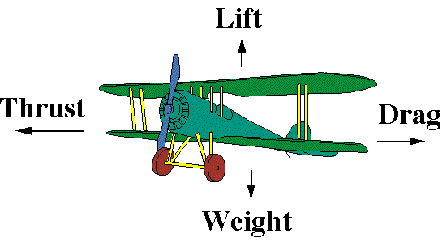

Slide 7
What Do I Do About My Past Failures?
Colossians 1:14—remember that all your sins have already been forgiven you in Jesus Christ
Hebrews 12:1—lay aside the weight of your sin and run the race.
Philippians 3:13-14—forget about your past failures and press on. Don’t let your past rob you of your future.
JUST GRACE IT—by faith apply the grace of God and move on.

